Slide 1
Data Analytics Dashboard
By,
Nishanth Raj
Priyanshu
Shivakumar M J
Suyog Kishor Bhamare

Slide 2
Introduction
An analytics dashboard is a collection of data focused on key metrics, presented neatly on a user interface.
It enables analysts to easily monitor the performance of a digital products.
Data Analytics Dashboard is a the credit monitoring unit of Axis Bank for wholesale banking customers.

Slide 3
Requirements
Spring Boot
Mongo DB
VS code
Postman

Slide 4
Services name-port number
Spring boot : 8080
Kafka : 9092
React Js : 3000
MongoDB : 27017

Slide 5
ER Diagram
Welcome
Users
Messages
Dashboard / Home
Interest of CBO SRM ID
Failure reason 1 count by CBO SRM ID
Analytics
Interest of Sol ID
Good customers by CBO SRM ID
Failure reason count by Sol ID
Failure reason 4 count by CBO SRM ID

Slide 6
Data Required
Spring boot is used in backend, where we can perform some business logics.
Apache Kafka is used to create a data pipeline for mongoDB and spring boot application.
MongoDB is used to store data
React Js is used in frontend for user interface.
Creating a web interface to show data visualizations for the analytics dashboard.

Slide 7
Analytics Dashboards
Total Interest Payment by CBO SRM - Visualizes the total amount of interest payment to be received from all customers mapped to a specific CBO SRM. This slide includes a line chart to display the total interest payment for each CBO SRM.
Total Interest Payment by SOL ID - Visualizes the total amount of interest payment to be received from all customers mapped to a specific SOL ID. This slide includes a line chart to display the total interest payment for each SOL ID.
Failure reason 1 and 4 by SOL ID - Visualizes the number of cases marked with failure reasons 1 and 4 by SOL ID
Failure reason 1 by CBO SRM
Failure reason 4 by CBO SRM
Good Customers by CBO SRM

Slide 8
Reasons
Technical glitch
Principal payment is not due this month
Normal interest is zero or customer has no interest due
Customer data missing

Slide 9
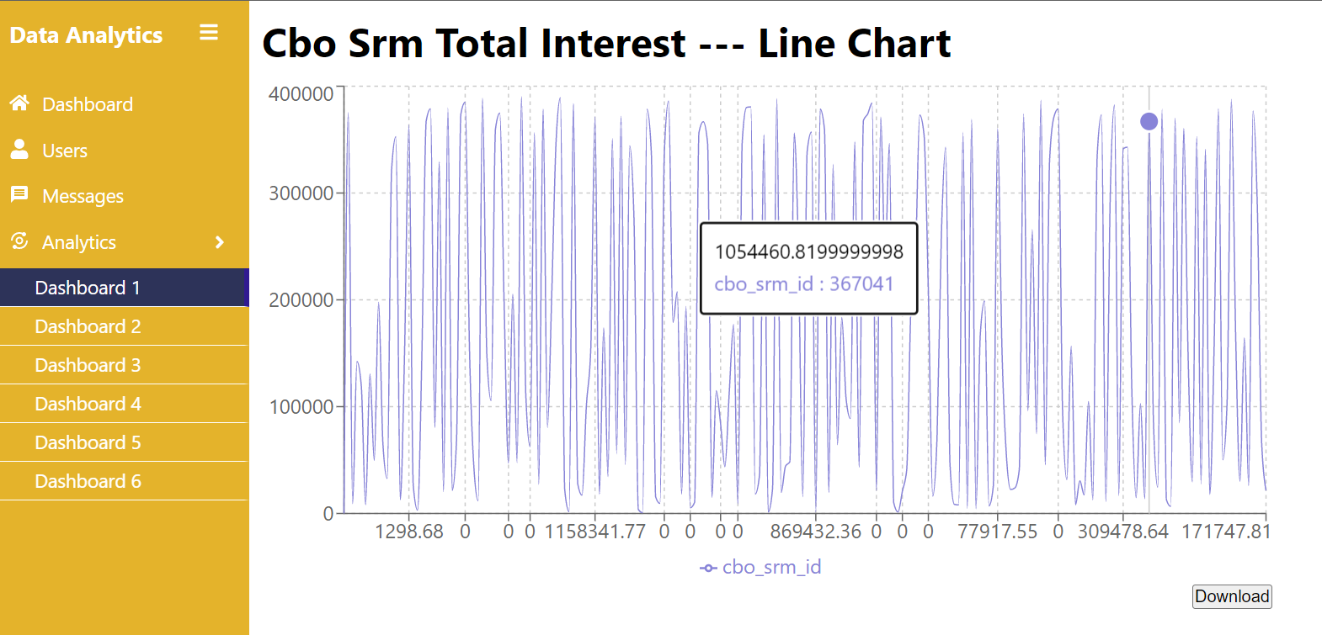
Total Interest Payment by CBO SRM
Visualizes the total amount of interest payment to be received from all customers mapped to a specific CBO SRM. This slide includes a bar chart to display the total interest payment for each CBO SRM.

Slide 10
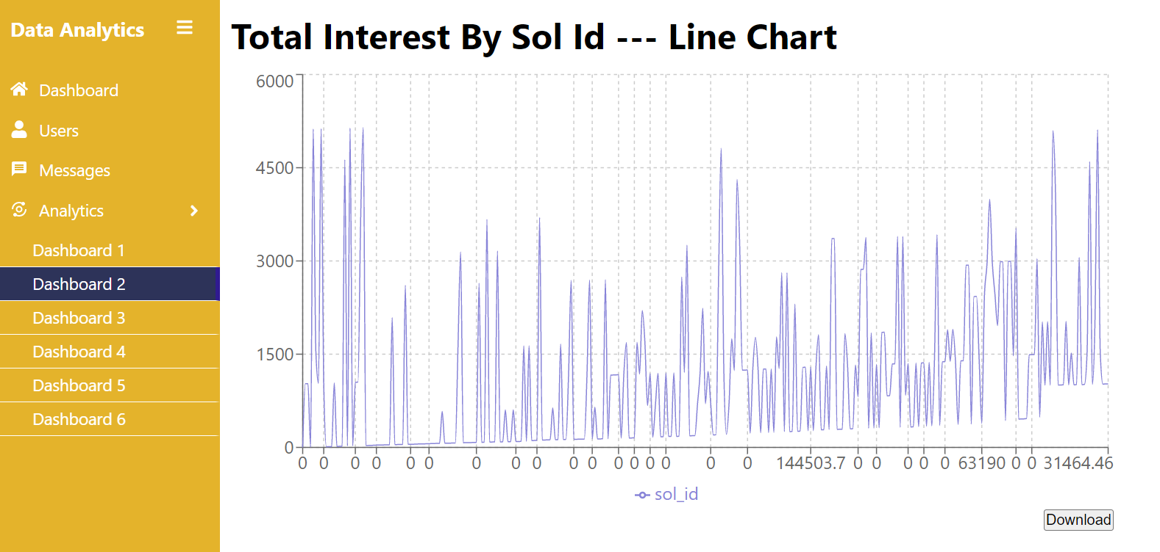
Total Interest Payment by SOL ID
Visualizes the total amount of interest payment to be received from all customers mapped to a specific CBO SRM. This slide includes a bar chart to display the total interest payment for each CBO SRM.

Slide 11
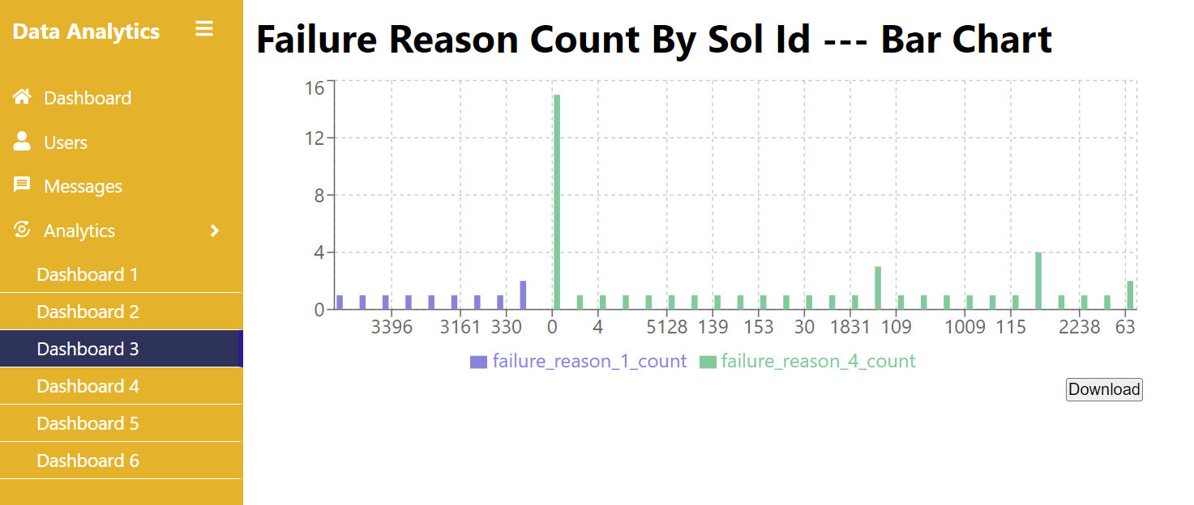
Failure Reason 1 and 4 by SOL
ID - Visualizes the number of cases marked with failure reasons 1 and 4 by SOL ID
Reason
Technical glitch
Customer data missing

Slide 12
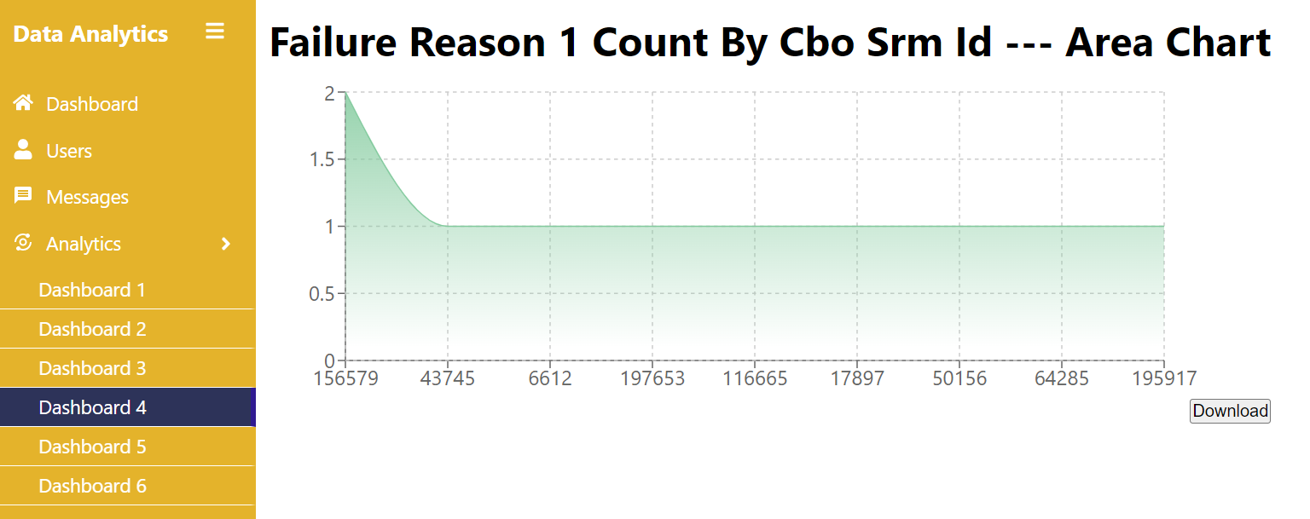
Failure Reason 1 by CBO SRM
Reason
Technical glitch

Slide 13
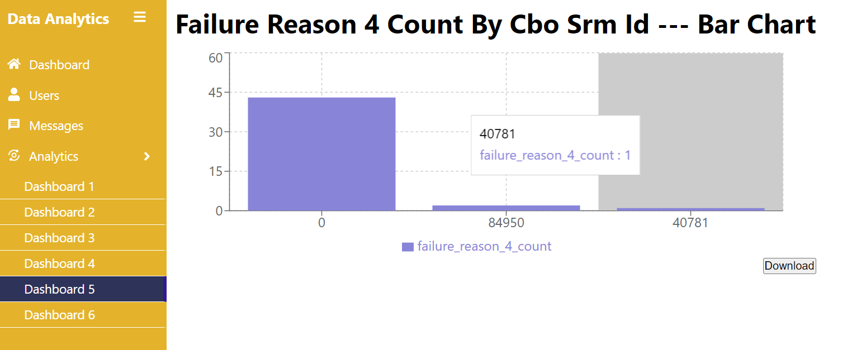
Failure Reason 4 by CBO SRM
Reason
Customer data missing: Customer email id is not present in bank system.

Slide 14
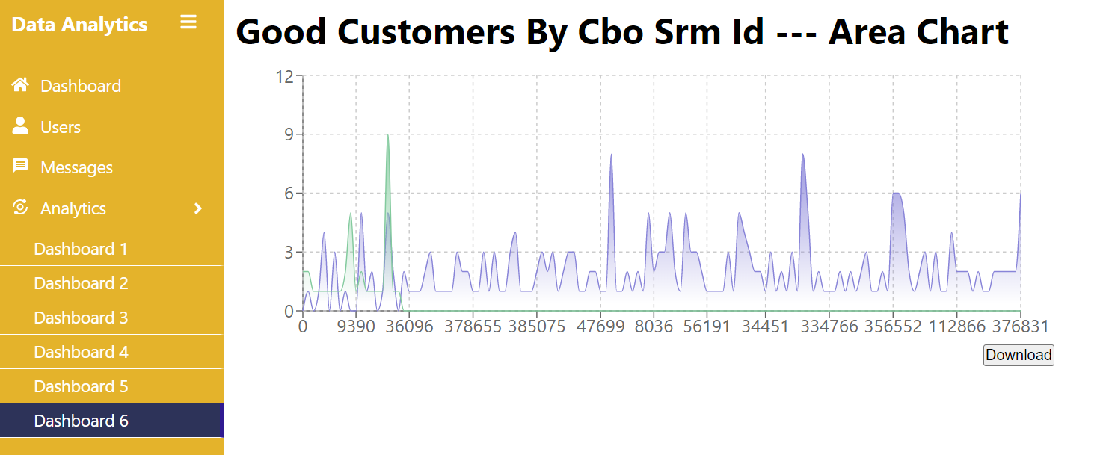
Good Customers by CBO SRM

Slide 15
Thank You

